Slide 1
Lecture 6b: Building Datapath for MIPS Instructions
To watch lecture video click link below
Lecture 6b video
To view slides, continue to next slide

Slide 2
Lecture 6b: Building Datapath for MIPS Instructions

Slide 3
The Processor: Datapath & Control
We will Implement the following MIPS instruction set:
arithmetic-logical instructions: add, sub, and, or
memory-reference instructions: lw, sw
control flow instructions: beq
Generic Implementation:
use the program counter (PC) to supply instruction address
get the instruction from memory
read registers
use the instruction to decide exactly what to do

Slide 4
Implementation Steps
Two common steps
Step1: Instruction fetch
Send the Program Counter (PC) to Instruction Memory (IM) to fetch the instruction;
Increase the PC by 4 – get ready for the next instruction.
Each instruction occupies one word, i.e. 4 bytes.
In case of branch instruction, PC will be further updated.
Step 2: Read operands
Read two registers using fields of the instruction to select the registers to read. For lw instruction, we need to read only one register (no harm to read 2nd one, just don’t use it).
Remaining steps
Depends on specific actions required by the instruction

Slide 5
More on Implementation Steps
Arithmetic-Logical Instructions: and, or, add, sub
Use ALU for opcode/function code execution
Write the data from ALU back to register
e.g. add R15, R14, R13
Memory –Reference Instructions: lw, sw
Use ALU for calculating effective address
Access memory for storing a word or loading a word
e.g. sw R15, 0x0100(R20)
Branch Instructions: beq
Use ALU for comparison
Change the next PC based on the comparison
e.g. beq R15, R0, 0x0100

Slide 6
How to Build up a Datapath
General methods
For each instruction,
Analyze the detailed actions of instruction execution step by step
Build up the datapath for each step
For all the instructions
The datapath for a processor should be able to execute any of the above instruction at a time;
Datapaths for different instructions share common functional units
Combine paths together using multiplexors

Slide 7
Step 1: Instruction Fetch (IF)
Actions
Fetch the instruction (read instruction memory with PC as address)
Instruction <= IM[PC] #here we borrowed programming notations to describe hardware actions
Increment PC (PC <= PC+4)
Building blocks
Instruction Memory (IM)
Program Counter (PC)
Adder
To increment the PC

Slide 8
Building Blocks for IF

Slide 9
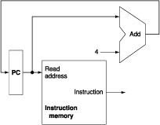
First Step: Linking Together
Instruction <= IM[PC]
PC<=PC+4
Strategy for linking:
Just simply connect each functional unit’s input and output, i.e. PC connects to IM’s Read address.

Slide 10
R-type Instructions
Remaining steps
Read two registers
ReadData1 <= Registers[rs]
ReadData2 <= Registers[rt]
Use ALU to compute the result
ALUResult <= ReadData1 op ReadData2
op: addition for add instruction, AND for and instruction, …
Write back the result to registers
Register[rd] <= ALUResult
Components involved: Registers and ALU

Slide 11
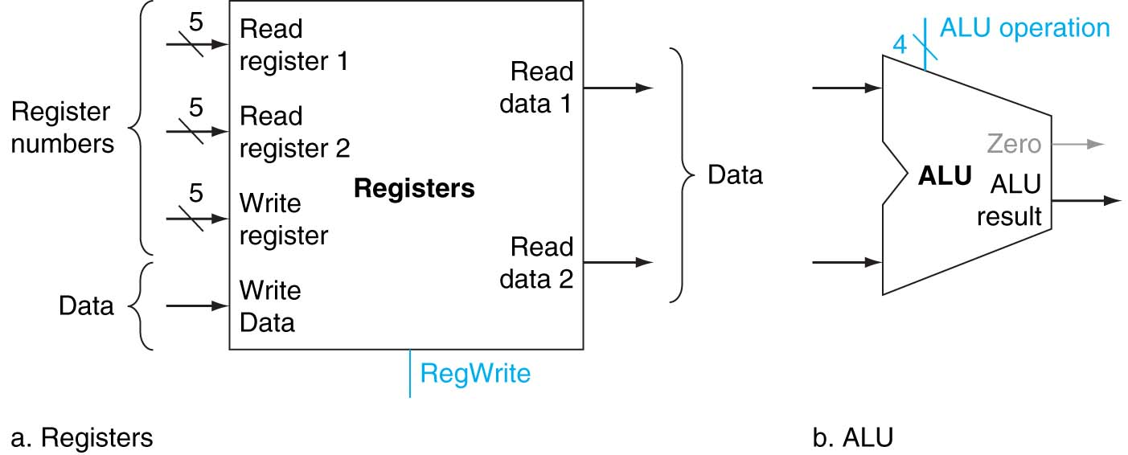
Building Blocks for R-type Instructions

Slide 12
R-type Instructions: Linking Together
rs
rt
rd

Slide 13
rs, rt, rd
From Step 1, we have read out from IM 32-bit instruction, and which is R-type (by assumption)
Recall R-type instruction format (reference: green sheet.)
A 32-bit instruction, leftmost is bit 31, rightmost is bit 0
Opcode (6 bits) uses bits 31 to 26, rs (5 bits) uses bits 25 to 21, …
Therefore, we could refer
rs ⬄ Instruction[25:21]
rt ⬄ Instruction[20:16]
rd ⬄ Instruction[15:11]
Opcode (31:26) | rs (25:21) | rt (20:16) | rd (15:11) | Shamt (10:6) | Funct (5:0)

Slide 14
R-type: Connecting with Step 1
rs
rt
rd
The green bar illustrates the 32-bit instruction from IM (not stored, just 32-bit data lines) with bits 26:21 connecting to Read reg 1; bits 20:16 to Read reg 2, and bits 15:11 to Write reg.

Slide 15
Load (lw) Instruction
Actions
Read two registers (2nd useless, so ignored)
ReadData1 <= Registers [rs]
Use ALU to compute memory address
Addr <= ReadData1 + SE(offset)
Offset: Instruction[15:0]
sign extension needed to convert offset (16-bit) to 32-bit before addition
Value from DM writes back to register
ReadData <= DM[Addr] #note: ReadData from DM
Reg[rd] = ReadData
Components involved:: Registers, ALU, DM, and SE

Slide 16
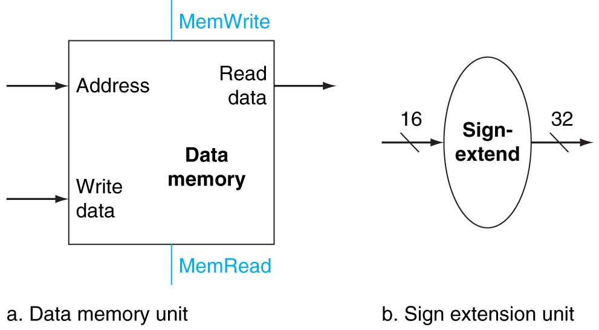
Linking Together
I-type
lw
Opcode(31:26) rs(25:21) rd(20:16) offset(15:0)
rs
rd
Instr[15:0]

Slide 17
Store (sw) Instruction
Actions
Read two Registers
ReadData1 <= Registers[rs]
ReadData2 <= Registers[rt]
Use ALU to compute memory address (same as lw)
Addr <= ReadData1 + SE(offset)
Write to DM
DM[Addr] <= ReadData2 #note: ReadData2 from Registers
Components involved
Registers, ALU, DM, and SE (sign extend)
Same as lw

Slide 18
Linking Together
I-type
sw
Opcode(31:26) rs(25:21) rt(20:16) offset(15:0)
rs
rt
Instr[15:0]
Here two lines not connected, just cross over.

Slide 19
Branch Equal (beq) Instruction
Actions
Read two Registers
ReadData1 <= Registers[rs] ReadData2 <= Registers[rt]
Use ALU to compute compare two values
ReadData1 – ReadData2 == 0?
(note: ALU performs subtraction, and Zero output will indicate the result isZero or not.)
Update PC
if (isZero) PC <= PC + SE(offset) #note: condition check will be done by control unit. No to worry at this moment.
Components involved: Registers, ALU, SE, adder
An additional adder for for PC + SE(offset)

Slide 20
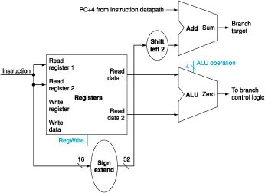
Datapath for beq

Slide 21
Why we need a ”shift left 2” unit?
byte address vs. word address
beq R8, R9, Label
and …
or …
j Exit
Label: sub R24, R20, R22
What should be the value for Label in instruction?
It’s an offset between beq and sub instructions
Remember after we fetch beq, PC already incremented by 4
So if branch taken, PC needs to point to sub instruction by adding additional 12 bytes (i.e. skipping 3 instructions)
MIPS put 3 (3 words) for Label in the instruction, but the actually PC needs to increase by 3 * 4 = 12 bytes
Shift left 2 ⬄ multiply by 4
Note: Some assembly may put R8, R9 order in instruction differently. Don’t care here as no affect to result.
beq opcode
R8
R9
Label
beq: I-type

Slide 22
Instruction Implementation: Summary
Instructions implemented
Add, sub, and, or, slt, lw, sw and beq
Actions and hardware components
Fetch instructions and increment PC (PC, IM, adder)
Read two operands (registers)
ALU
R-type: ALU operations as defined by the function code
Lw & sw: add offset with base register value for calculating effective address
Beq: compare two registers to see if equal
DM (lw & sw) or update PC (beq)
Write back register (R-type instructions and lw)

Slide 23
Special Notes to the Datapath
R-type instructions (and, or, add, sub) share the exact same datapath.
The only difference among these instructions is the ALU operation, i.e. overall instruction execution for these four instruction is the same, but ALU will perform and, or, add, sub respectively (see Lecture 6d ALU control.)
It’s no harm to read the second register in case of lw as the value of the second register will not be used.
In case of beq, PC increment will not be performed by the ALU. In addition, a special adder is used to increment PC.

Slide 24
Thinking Question
MIPS has an I-type addi instruction. It works as follows:
addi R14, R12, 0x0014
Meaning: Regs[14] <= Regs[12] + SE (0x0014)
Could you build up a datapath for the addi instruction?
opcode (6 bits) | 01100 (R12) (5 bits) | 01110 (R14) (5 bits) | 0000 0000 0001 0100 (16-bit immediate)

Slide 25
Summary
Implemented each instruction individually
Next lecture: putting together into one datapath
What you should understand
Actions in each step of execution
Hardware unit to perform each action
Linking units together to form the datapath

